Slide 1

Data Analysis
Notes:
---
Welcome to our Data Analysis with Python tutorial.
My name is Santiago, and I'm an instructor at RMOTR.com, an online Data Science academy.
This tutorial is the result of a joint effort by RMOTR and freecodecamp and it's totally free. It includes Slides, Jupyter Notebooks and coding exercises.

Slide 2

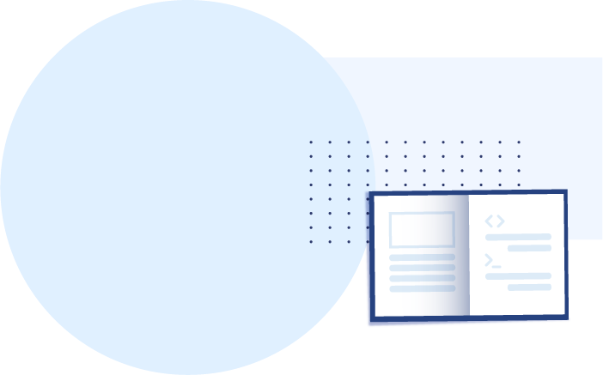
About this tutorial
What is Data Analysis
Real example Data Analysis with Python
How to use Jupyter Notebooks

Slide 3
What is Data Analysis?

Slide 4
What is Data Analysis
A process of inspecting, cleansing, transforming and modeling data with the goal of discovering useful information, informing conclusion and supporting decision-making.
Definition by Wikipedia

Slide 5
Data Analysis Tools

Slide 6

Data Analysis Tools
Excel
Power Pivot
Power Query
Power BI
Microsoft SQL
Python
Jupyter Notebook

Slide 7
Why Python
for Data Analysis?

Slide 8

Why Python for Data Analysis?
👍 very simple and intuitive to learn
👍 “correct” language
👍 powerful libraries (not just for Data Analysis)
👍 free and open source
👍 amazing community, docs and conferences

Slide 9
The Data Analysis
Process

Slide 10
Data Extraction
Data Cleaning
Data Wrangling
Analysis
Action
SQL
Scrapping
File Formats
  CSV
  JSON
  XML
Consulting APIs
Buying Data
Distributed Databases
Missing values and empty data
Data imputation
Incorrect types
Incorrect or invalid values
Outliers and non relevant data
Statistical sanitization
Hierarchical Data
Handling categorical data
Reshaping and transforming structures
Indexing data for quick access
Merging, combining and joining data
Exploration
Building statistical models
Visualization and representations
Correlation vs Causation analysis
Hypothesis testing
Statistical analysis
Reporting
Building Machine Learning Models
Feature Engineering
Moving ML into production
Building ETL pipelines
Live dashboard and reporting
Decision making and real-life tests

Slide 11
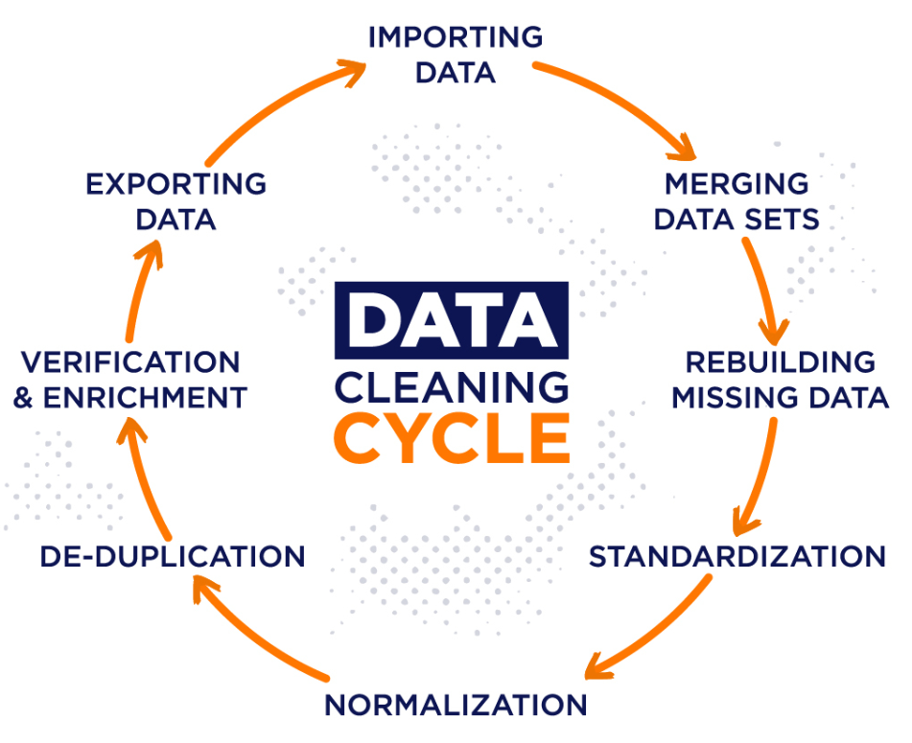

Slide 12
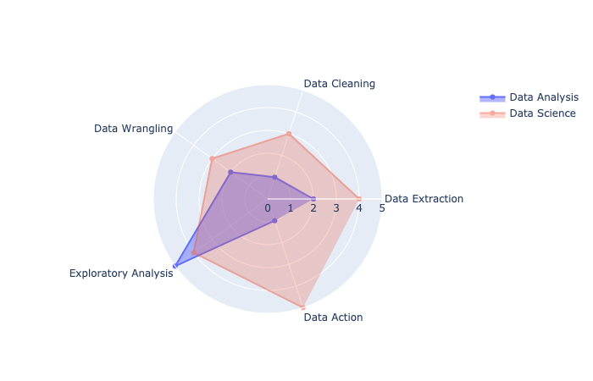
DATA ANALYSIS VS DATA SCIENCE
The traditional view

Slide 13
What is dirty data?
Data is deemed dirty when it has the following characteristics:
Duplicate information
Incomplete (think missing contact fields)
Outdated
Incorrectly input
Misspellings, typos, and multiple spelling variations

Slide 14
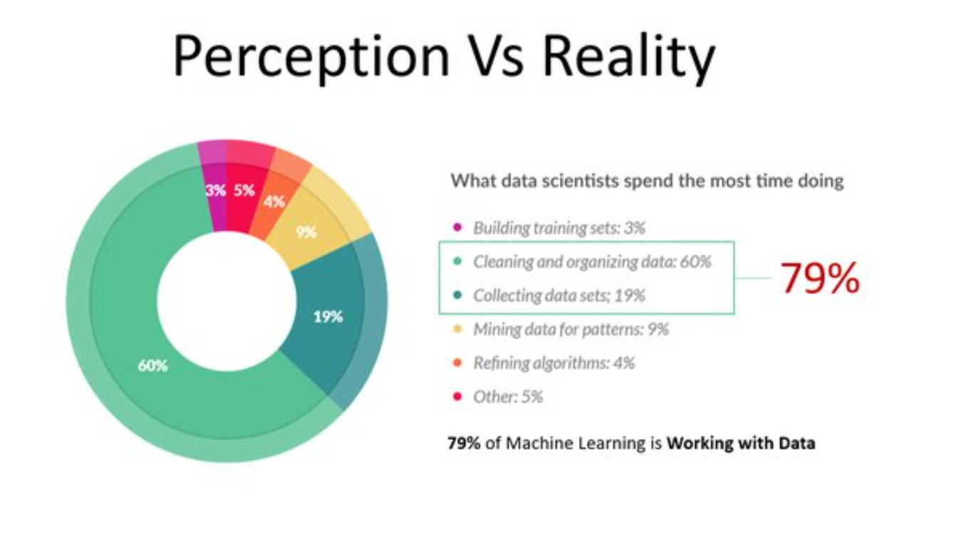

Slide 15
Python & PyData Ecosystem

Slide 16
PYTHON ECOSYSTEM:
The libraries we use...
pandas: The cornerstone of our Data Analysis job with Python
matplotlib: The foundational library for visualizations. Other libraries we’ll use will be built on top of matplotlib.
numpy: The numeric library that serves as the foundation of all calculations in Python.
seaborn: A statistical visualization tool built on top of matplotlib.
statsmodels: A library with many advanced statistical functions.
scipy: Advanced scientific computing, including functions for optimization, linear algebra, image processing and much more.
scikit-learn: The most popular machine learning library for Python (not deep learning)

Slide 17
Thank you
Notes:
Let’s explore the Python and PyData ecosystem. All the tools and libraries that we’ll be using.

